Slide 1
Risk Matrix

Slide 2
INTRODUCTION
Risk Matrix
A risk matrix is a matrix that is used during risk assessment to define the level of risk by considering the category of likelihood against the category of consequence severity. This is a simple mechanism to increase visibility of risks and assist management decision making.
Core Purpose of Risk Matrix
The purpose of a risk matrix is to provide a structured and visual way to assess and prioritize risks by evaluating the likelihood and impact of potential events, helping organizations make informed decisions about risk management and resource allocation.

Slide 3
Dataset Description
The dataset is sourced from a sample risk data consisting of four major categories-Finance, Infrastructure, Safety & Security along with their Risk IDs.
This dataset comprises of likelihood and severity values:
Likelihood values
1 Rare : A very slim chance for this risk to occur.
2 Unlikely : Low chances for this risk to occur.
3 Possible : Fifty-fifty chances for this risk to occur.
4 Likely : Good chances for this risk to occur.
5 Almost Certain : You can bet this risk will occur at some point.
Severity values
1 Negligible : The risk will have little consequences if occurs.
2 Minor : The consequences of the risk will be easy to manage.
3 Moderate : The consequences of the risk will take time to mitigate.
4 Major : The consequences of this risk will be significant and may cause long-term damage.
5 Catastrophic : The consequences of this risk will be detrimental and may be hard to recover from.

Slide 4
P
O
W
E
R
B
I
S
T
A
G
E
S
01
Import & Load Data
Getting data from various sources into PowerBi for analysis and reporting.
02
Clean & Transform Data
Prepare and shape the data to ensure its quality and usability.
03
Build Data Model
Create relationships between tables and organize data for efficient analysis.
04
Write Formulas in DAX
Write formulas in DAX to perform calculations and derive insights using measures etc.
05
Design Report using Visuals
Create visually appealing and interactive charts and graphs to represent data.

Slide 5
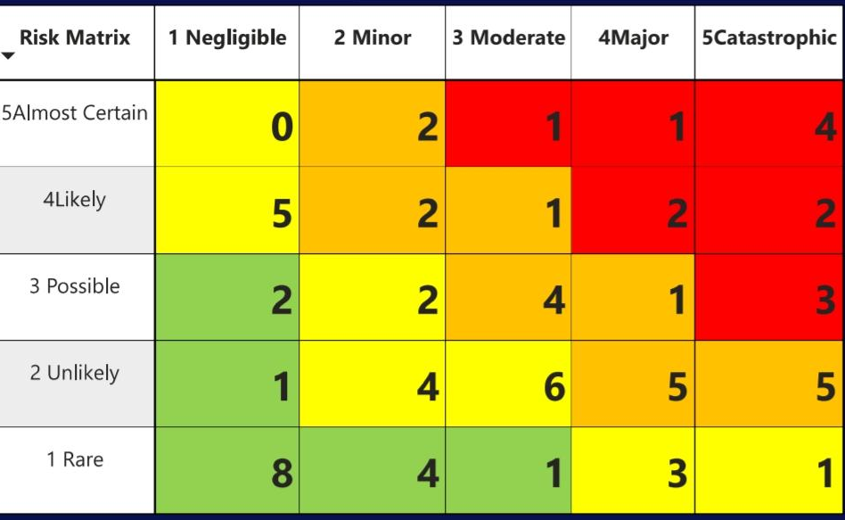
Extreme
High
Moderate
Low
70
CONSEQUENCE
Total Risks
L
I
K
E
L
I
H
O
O
D
Risk Matrix Visual

Slide 6
P
R
E
C
A
U
T
I
O
N
S
01
Thorough Brainstorming: Thorough Brainstorming is required to identify errors and clean data.
Error Identification
02
Clear and Consistent Scales: To use consistent and well-defined scales for both likelihood(e.g., almost certain, likely, possible, unlikely, rare ) and severity(e.g., negligible, minor, moderate, major, catastrophic)
Avoid Ambiguity: Ensure that each level on the scale is clearly defined to avoid subjective interpretations.
Defining Likelihood and Severity Criteria
03
Accurate Risk Assessment: To score risks on the basis of their likelihood and severity, and prioritize risks accordingly.
Risk Assessment and Prioritization

Slide 7

Risk Matrix in Real World
Real Life Case Study
This risk matrix was prepared for the ‘Funafuti Green Waste Management Program’ – a program which is being implemented by the Solid Waste Authority of Tuvalu (SWAT) and which is part of the National Integrated Waste Policy and Action Plan (2016).
The overall objective of the Funafuti Green Waste Management program is to ‘reduce the volume of green waste going to landfill’. The program design includes three inter-related strategies to achieve the overall project objective.
Supply Chain Management
Strategic Planning
Project Management
Financial Risk Assessment

Slide 8
References
Power BI Tutorial: Create An Advanced Risk Matrix Visual - P2 | NextGen BI Guru
https://youtu.be/SgxENdJc890?si=x3iDMyuNC9kAnJgs

Slide 9
THANK YOU

